Slide 1
Greening the Spark a hands-on model for museums
by Carl Nicholson
Autumn 2022
Notes:
This template can be used as a starter file for presenting training materials in a group setting.
Sections
Right-click on a slide to add sections. Sections can help to organize your slides or facilitate collaboration between multiple authors.
Notes
Use the Notes section for delivery notes or to provide additional details for the audience. View these notes in Presentation View during your presentation.
Keep in mind the font size (important for accessibility, visibility, videotaping, and online production)
Coordinated colors
Pay particular attention to the graphs, charts, and text boxes.
Consider that attendees will print in black and white or grayscale. Run a test print to make sure your colors work when printed in pure black and white and grayscale.
Graphics, tables, and graphs
Keep it simple: If possible, use consistent, non-distracting styles and colors.
Label all graphs and tables.

Slide 2
Introduction
“Greening the Spark” (GTS) is a hands-on model of a system for electricity
Generation
Distribution
Storage and
Consumption
for promoting awareness of electrical energy as a vital part of our economy and the impact it can have on the environment.
It is being developed as a feasibility study / prototype for an installation to be used as a:
Museum exhibit and hands-on game for kids and adults alike
Teaching aid for use in schools and universities
Demonstrator for science fairs and exhibitions
Notes:
Give a brief overview of the presentation. Describe the major focus of the presentation and why it is important.
Introduce each of the major topics.
To provide a road map for the audience, you can repeat this Overview slide throughout the presentation, highlighting the particular topic you will discuss next.

Slide 3
Context
Which questions GTS is intended to answer and which not.
Prior knowledge (out of scope):
What is electricity?
What is electricity used for?
Scope:
Where does our electricity come from?
How does electricity get to where it's needed?
How are electricity supply and demand matched?
How much of world energy consumption is electric?
How much electric power comes from each kind of source?
What is green electricity and how green is it?
What are the relative costs of each type, both financially and in terms of environmental impact?
What types of electrical energy storage are there, how much is needed and what are their costs?
Further questions (currently out of scope):
How safe are the different types of electricity production?
How green will electricity be by 2030 and 2050?
Will we have the resources to build and fuel enough electricity production and storage for future consumption?
When will nuclear fusion be a viable source of electrical energy?
etc.
Notes:
Give a brief overview of the presentation. Describe the major focus of the presentation and why it is important.
Introduce each of the major topics.
To provide a road map for the audience, you can repeat this Overview slide throughout the presentation, highlighting the particular topic you will discuss next.

Slide 4
Development
GTS has been developed from scratch, starting with a new pencil and a fresh drawing board. Development path is:
Proof of concept.
This successfully demonstrated the basic functions of both hardware and software.
General purpose simulator.
This was a software development exercise to increase modularity and scalability and provide a more flexible approach to simulation timing.
Museum installation working model.
This is a “serving suggestion” as to how a museum installation might look and is work in progress.
Notes:
Give a brief overview of the presentation. Describe the major focus of the presentation and why it is important.
Introduce each of the major topics.
To provide a road map for the audience, you can repeat this Overview slide throughout the presentation, highlighting the particular topic you will discuss next.

Slide 5
Implementation
Software:
The models are developed in a Python 3.7 IDE on a PC running Windows 10.
The target environment is a Raspberry Pi 4B, operated remotely from a PC or mobile device.
Approximately 10,000 lines of code.
Hardware:
Visitor & staff control panels
Grid Monitoring and Control System panel
Dynamic representations of wind and solar farms
Themed landscape & signage to provide context and information
Notes:
Give a brief overview of the presentation. Describe the major focus of the presentation and why it is important.
Introduce each of the major topics.
To provide a road map for the audience, you can repeat this Overview slide throughout the presentation, highlighting the particular topic you will discuss next.

Slide 6
Part I
Greening the Spark
The Museum Installation
Notes:
Give a brief overview of the presentation. Describe the major focus of the presentation and why it is important.
Introduce each of the major topics.
To provide a road map for the audience, you can repeat this Overview slide throughout the presentation, highlighting the particular topic you will discuss next.

Slide 7
Infrastructure
The following infrastructure elements of a typical national electricity grid are modelled in software:
Wind power
Solar power
Fossil fuels power
Nuclear power
Battery storage
Pumped hydroelectric storage
Grid monitoring and control system
Notes:
Give a brief overview of the presentation. Describe the major focus of the presentation and why it is important.
Introduce each of the major topics.
To provide a road map for the audience, you can repeat this Overview slide throughout the presentation, highlighting the particular topic you will discuss next.

Slide 8
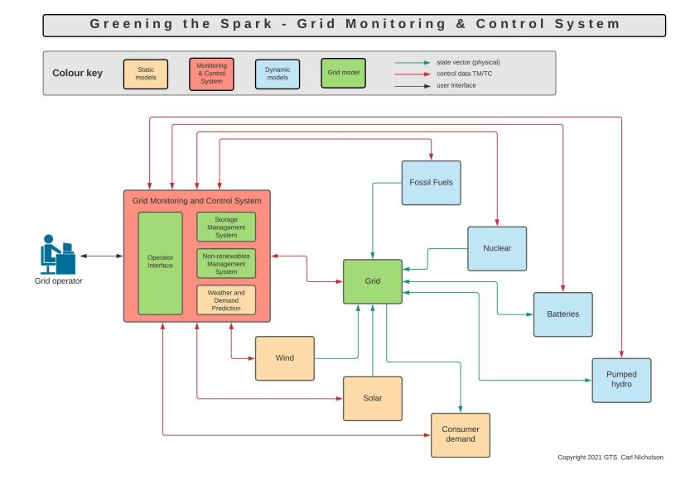
Infrastructure
Notes:
Give a brief overview of the presentation. Describe the major focus of the presentation and why it is important.
Introduce each of the major topics.
To provide a road map for the audience, you can repeat this Overview slide throughout the presentation, highlighting the particular topic you will discuss next.

Slide 9
The models
Scenarios are presented as predefined models of:
Weather (wind, sun) and
Consumer demand
Forecasts are provided for each scenario.
Fossil fuels and nuclear power generation are under operator control or autonomously by a Non-renewables Management System.
Storage elements are autonomous and controlled by a Storage Management System.
Overall management of the grid is provided by the Grid Monitoring and Control System.
Notes:
Give a brief overview of the presentation. Describe the major focus of the presentation and why it is important.
Introduce each of the major topics.
To provide a road map for the audience, you can repeat this Overview slide throughout the presentation, highlighting the particular topic you will discuss next.

Slide 10
Example scenario
Notes:
Give a brief overview of the presentation. Describe the major focus of the presentation and why it is important.
Introduce each of the major topics.
To provide a road map for the audience, you can repeat this Overview slide throughout the presentation, highlighting the particular topic you will discuss next.

Slide 11
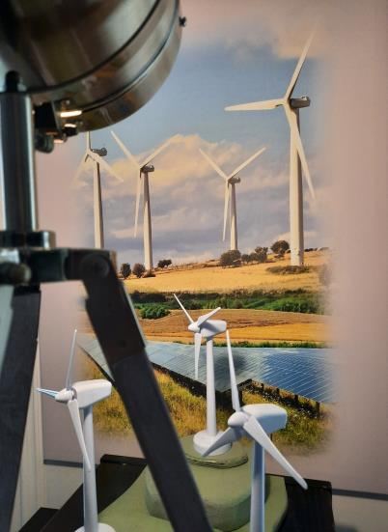
Representations
Sun lamp
Background wind and solar farm
Model wind turbines
Notes:
Give a brief overview of the presentation. Describe the major focus of the presentation and why it is important.
Introduce each of the major topics.
To provide a road map for the audience, you can repeat this Overview slide throughout the presentation, highlighting the particular topic you will discuss next.

Slide 12
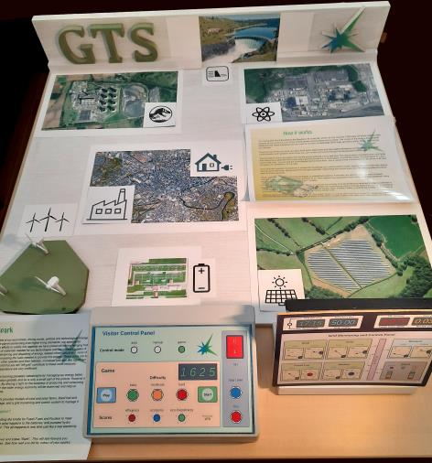
Layout and theming
Pumped hydro electric storage
Fossil fuels power station
Nuclear power station
Consumer demand
Signage
Fossil fuels power station
Solar farm
Battery storage
Operator control panel
Staff and visitor control panels
Notes:
Give a brief overview of the presentation. Describe the major focus of the presentation and why it is important.
Introduce each of the major topics.
To provide a road map for the audience, you can repeat this Overview slide throughout the presentation, highlighting the particular topic you will discuss next.

Slide 13
The experience
Visitor experience:
Exhibit mode: real time autonomous operation until controls are touched, then it becomes hands-on and the visitor assumes the role of grid operator controlling fossil fuels and nuclear power to balance the grid and maintain storage capacity.
Game mode: at 144 times real time, this can be played as a game with 24 hours of game time passing in 10 minutes. There are three difficulty levels. At game over “sparks” are awarded for performance. Game results are posted to an online database where they can be accessed with a unique game number.
Eye-catching themed physical model with working model wind turbines, “sun” and real hardware control panels.
Supported by signage with textual descriptions and artwork as required.
Audio provides sound effects and background soundscape, and three “characters” to inform and entertain, using Google Cloud Services voice synthesis.
Staff experience:
Simple to switch on and off via the staff control panel
Test mode allows for easy checking and troubleshooting
Can also be accessed by mobile phone app / laptop.
Notes:
Give a brief overview of the presentation. Describe the major focus of the presentation and why it is important.
Introduce each of the major topics.
To provide a road map for the audience, you can repeat this Overview slide throughout the presentation, highlighting the particular topic you will discuss next.

Slide 14
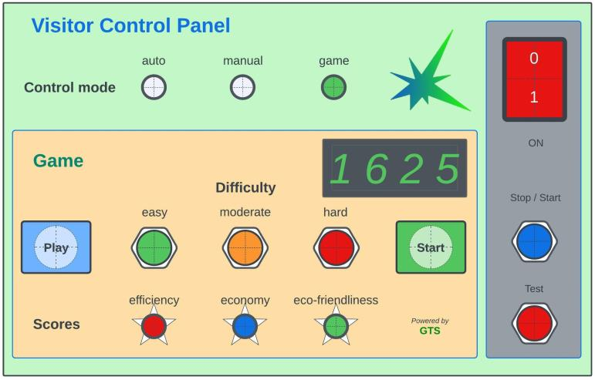
Visitor & staff control panels
Notes:
Give a brief overview of the presentation. Describe the major focus of the presentation and why it is important.
Introduce each of the major topics.
To provide a road map for the audience, you can repeat this Overview slide throughout the presentation, highlighting the particular topic you will discuss next.

Slide 15
Grid Monitoring and Control
At the heart of the GTS is the Grid Monitoring and Control System which manages the grid and connected elements, providing the following functions:
Reception of telemetry from grid elements containing power, energy and status information
Operator interface for manual monitoring and control via a control panel
Grid control laws for determining how power is allocated to / from the grid elements, implemented as:
Storage Management System determining when and where energy is to be stored / retrieved
Non-renewables Management System for controlling the power generated by the fossil fuels and nuclear power stations
Telecommand system for transmitting control information to each element
Calculation of derived data, such as cumulative energy, utilisation, CO₂ footprint and costs
Generation and collection of data for game results display, further inspection and analysis.
Notes:
Give a brief overview of the presentation. Describe the major focus of the presentation and why it is important.
Introduce each of the major topics.
To provide a road map for the audience, you can repeat this Overview slide throughout the presentation, highlighting the particular topic you will discuss next.

Slide 16
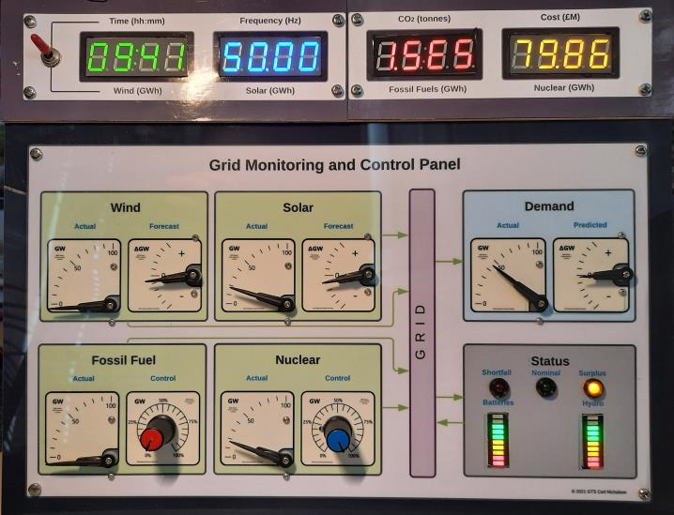
Monitoring and Control Panel
Numeric displays
Display selection
Power gauge
Forecast gauge
Control knob
Grid status indicator
Storage status indicator
Notes:
Give a brief overview of the presentation. Describe the major focus of the presentation and why it is important.
Introduce each of the major topics.
To provide a road map for the audience, you can repeat this Overview slide throughout the presentation, highlighting the particular topic you will discuss next.

Slide 17
Difficulty levels
Three difficulty levels are implemented:
easy,
moderate and
hard.
These affect the models in the following ways:
Weather (wind, sun) and consumer demand are more volatile.
Forecasts are increasingly inaccurate.
Storage capacity and power are reduced, making balancing the grid a more demanding task.
Notes:
Give a brief overview of the presentation. Describe the major focus of the presentation and why it is important.
Introduce each of the major topics.
To provide a road map for the audience, you can repeat this Overview slide throughout the presentation, highlighting the particular topic you will discuss next.

Slide 18
Reporting
A report is generated at the end of each game containing:
Summary data
Game number, date and time
Total energy generated, used and stored
Overall utilisation of each energy source
Total and average costs incurred and CO₂ produced
Comments & scores for the three sparks or Electrical “E”s:
Efficiency
Eco-friendliness
Economy
Sparks earned – a final judgment on overall performance:
Red spark - worst
Blue spark - intermediate
Green spark – best
Timeline plots – showing exactly what happened and when:
Scenario (wind, sun and demand)
Controls (Fossil Fuels and Nuclear)
Consequences (energy storage and grid surplus/shortfall
Reports and other game related data are stored locally and in the online database.
Notes:
Give a brief overview of the presentation. Describe the major focus of the presentation and why it is important.
Introduce each of the major topics.
To provide a road map for the audience, you can repeat this Overview slide throughout the presentation, highlighting the particular topic you will discuss next.

Slide 19
Simulation Report
Simulation Report 2021-11-29 17:35:10
=================================
Configuration file: game.cfg
Simulation start time: 00:00:00
Simulation end time: 23:59:57
Simulation run time: 1 day, 0:00:00
Energy totals (GWh) and comments
-----------------------------------------------------------------------------------------------------
Demand 984.00
Wind 139.37
Solar 200.00
Fossil fuels 413.14
Nuclear 339.45
Surplus 175.11 could do better
Shortfall 0.01 excellent
Initial stored 180.00
Final stored 112.85
Storage discrepancy 67.15 OK
Efficiency score 89 OK
Carbon footprint and costs with scoring and comments
------------------------------------------------------------------------------------------------------------------------
Total CO2 (tonnes) 223541.32
Total cost (£M) 129.86
Ave CO2 (tonnes/GWh) 227.18 45 OK
Ave cost (£M/GWh) 0.13 55 OK
=========================================================================
Sparks earned: Efficiency Eco Economy
<blue> <blue> <blue>
=========================================================================
Notes:
Give a brief overview of the presentation. Describe the major focus of the presentation and why it is important.
Introduce each of the major topics.
To provide a road map for the audience, you can repeat this Overview slide throughout the presentation, highlighting the particular topic you will discuss next.

Slide 20
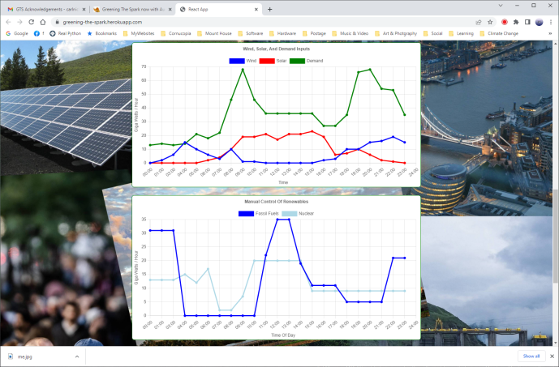
Simulation Report - plots
Notes:
Give a brief overview of the presentation. Describe the major focus of the presentation and why it is important.
Introduce each of the major topics.
To provide a road map for the audience, you can repeat this Overview slide throughout the presentation, highlighting the particular topic you will discuss next.

Slide 21
Part II
Greening the Spark
The Future
Notes:
Give a brief overview of the presentation. Describe the major focus of the presentation and why it is important.
Introduce each of the major topics.
To provide a road map for the audience, you can repeat this Overview slide throughout the presentation, highlighting the particular topic you will discuss next.

Slide 22
Museums
Here is a wish list for possible future innovations:
Online access to game results database
GUI control panels accessible over the internet
AI driven grid management
Better data visualisation
Modular hardware for expansion of control panels
Live streaming of real National Grid data
Quantitative static exhibit.
Notes:
Give a brief overview of the presentation. Describe the major focus of the presentation and why it is important.
Introduce each of the major topics.
To provide a road map for the audience, you can repeat this Overview slide throughout the presentation, highlighting the particular topic you will discuss next.

Slide 23
Schools and universities
“Greening the Spark” is provided as an open-source project acting as a blueprint for an interdisciplinary approach to system design, building and development.
Key selling points:
Modular open source hardware and software
Embraces design, modelling, gaming, spreadsheets, programming, IoT, electronics and mathematics
Encourages teamwork and innovation
Promotes energy costs and climate change awareness
Unlimited scope for development, including: new models & theming, remote access, live streaming of National Grid data, networking with other installations, GUI design, AI control, data analysis and presentation, 3D printing etc.
Notes:
Give a brief overview of the presentation. Describe the major focus of the presentation and why it is important.
Introduce each of the major topics.
To provide a road map for the audience, you can repeat this Overview slide throughout the presentation, highlighting the particular topic you will discuss next.

Slide 24
Science fairs and exhibitions
“Greening the Spark” is implemented as a portable turnkey demonstrator for incorporation into an existing exhibitor stall.
Key selling points:
Eye-catching themed physical model
Simulates basic characteristics of a real electricity grid
Interactive operation via a physical control panel
Promotes energy costs and climate change awareness
Can be controlled by mobile phone app / laptop
Notes:
Give a brief overview of the presentation. Describe the major focus of the presentation and why it is important.
Introduce each of the major topics.
To provide a road map for the audience, you can repeat this Overview slide throughout the presentation, highlighting the particular topic you will discuss next.

Slide 25
Website
“Greening the Spark” is documented at:
https://www.cornucopia.co.uk/gts/
or accessed by scanning the following QR code:
Notes:
Give a brief overview of the presentation. Describe the major focus of the presentation and why it is important.
Introduce each of the major topics.
To provide a road map for the audience, you can repeat this Overview slide throughout the presentation, highlighting the particular topic you will discuss next.

